Slide 1


MGMT 683: IT Innov And Comp Advantage Capitalizing on Houston's AirBnb momentum
Team 22
AA
Pooja Udayanjali Kannuri
Ann Mathew
Archita Ray
Abithaa Shree Venkatesh

Slide 2

Contents
Executive Summary
Business Problem Statement
Data Summary
Modelling
Business Insights
References

Slide 3
Executive Summary
Executive Summary
To propose a strategic roadmap for elevating business performance within the hospitality sector on Airbnb. This involves a concerted effort to bolster overall ratings through an unwavering commitment to service excellence, coupled with a tactical approach to augmenting occupancy rates. By adeptly managing reservations, cultivating positive reviews, and optimizing pricing strategies, hosts can significantly impact guest satisfaction and maximize revenue potential.
Assumptions
Only the properties which generate revenue impact our analysis
The analysis currently excludes considerations for seasonality, focusing on general patterns and factors influencing overall ratings.

Slide 4

Business Problem
Business Problem Statement
Airbnb's strategic initiatives aim to focus on two key areas to enhance brand recognition and maintain market competitiveness:
Predicting overall guest ratings to improve satisfaction
To predict overall ratings and identify key factors to enhance host satisfaction and boost revenue
Predicting Occupancy Rates for Enhanced Market Competitiveness
This predictive model forecasts occupancy rates using key factors like the number of reviews, reservations, and nightly rates to help hosts optimize revenue.
This dual-pronged strategy aims to empower hosts with actionable insights, enhancing service quality and boosting platform competitiveness.

Slide 5
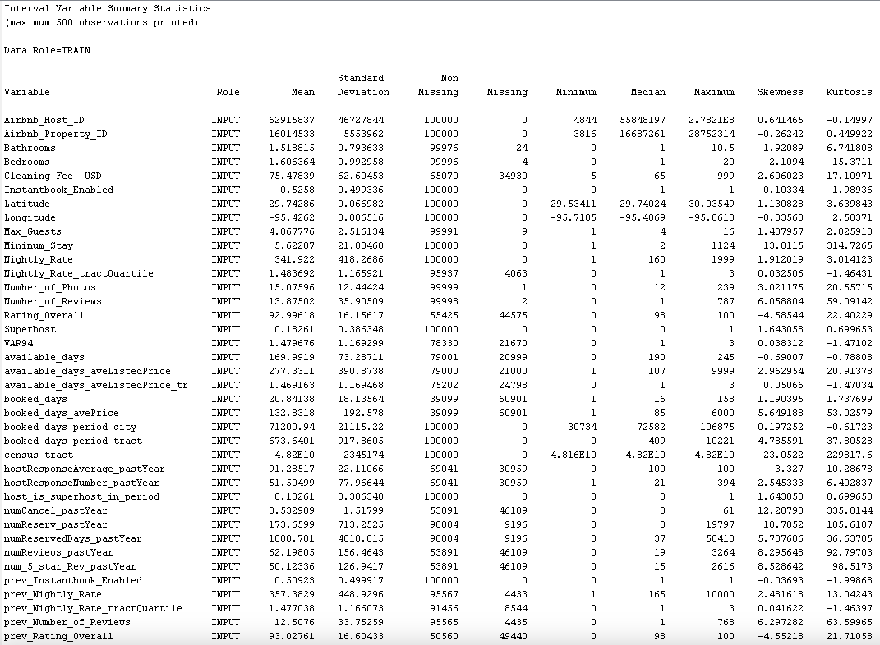




Data Source
Data Insights
airbnb_Houston.csv
Data Size ~146MB
Market Diversity
Balanced
Representation
Tourist Attractions
Data Insights
Number of Rows: 118,677 Number of Columns: 111 | Number of Numerical Columns: 103 Number of Categorical Columns: 7
Columns with no entries: Neighborhood (Categorical), Integrated Property Manager (Categorical)

Slide 6
Overall Guest Ratings
Data Insights
Showcases extremely positive guest experience on Airbnb, with a staggering 88% of the properties scoring sky-high ratings of 90-100
Only a handful fall below the 20 rating mark, making a stay in an Airbnb in this area almost a sure bet for a fantastic experience.

Slide 7
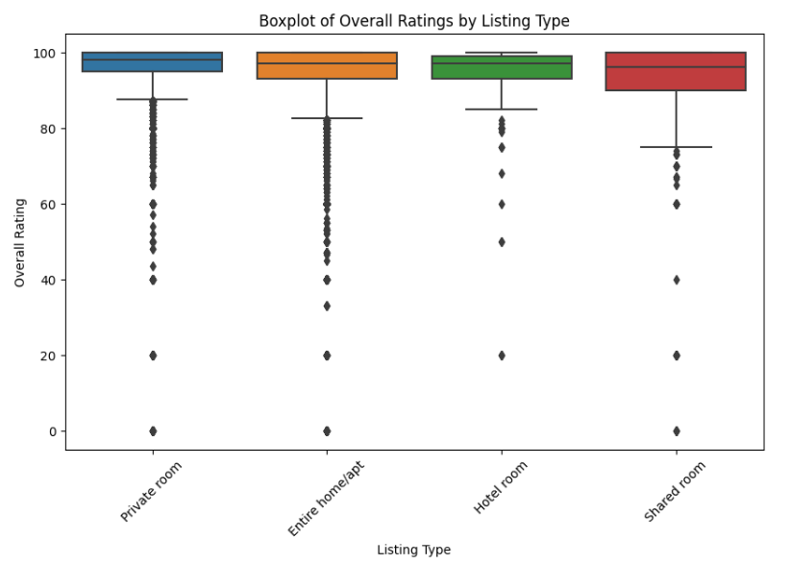
Outlier Handling
Data Insights
Outliers Reflect Reality: Highlight the extremes of guest experiences, essential for understanding overall property performance
Valuable Data Points: Genuine outliers provide crucial insights for predictive models, spotlighting issues like cleanliness and host responsiveness.
Robust Modeling: Training with outliers prepares the model for unusual cases, enhancing its robustness.
Overfitting risk: Models might be overfitted to the outliers, learning noise rather
than the signal, which could reduce generalizability.

Slide 8
Handling missing data
01
02
03
04
05
06
Data Preprocessing
Revenue
Replace with 0
Group by ID
Dropped all columns with blank revenue
Based on business context replacing blank with 0 for columns like cleaning fee etc.
Replacing missing values for numerical columns based on median of property ID group
Standardize
Elbow Method
Cluster
Enhancing algorithm performance and fairness across different scales and units.
Found 16 as optimal number of centroids using elbow method
Fill in remaining missing values by k means clustering, cluster mean for numerical and mode for categorical

Slide 9

Objective
Revenue
Overall Rating
Occupancy Rating
Although rating does not have strong direct correlation with Revenue, maintaining a healthy portfolio of listings on the site will boost network effect and customer loyalty
Occupancy Rate has around a 30% correlation with Revenue, a good metric for hosts to consider to boost they’re earnings

Slide 10
Our Approach
Modelling
Stratified sampling based on Property Type to get a healthy mix of population.
Sampling
Utilised both 60:40 & 75:25 split for the data partition.
Split Train & Test
Handled categorical variables to evaluate its impact on target variable.
One hot Encoding
Experimented with different scaler transformations on the numerical columns. ex: MaxAbsScaler(), StandardScaler()
Transformations

Slide 11
Model 1: Unveiling Impactful Features for predicting Overall Ratings for Enhanced Host Satisfaction
Results & Interpretation
1
Feature Selection
2
Model Selection
3
Result : Final Model
Model | Train R2 | Valid R2 | Train RMSE
Linear Regression | 0.5070 | 0.4682 | 5.91
Random Forest | 0.8489 | 0.8380 | 10.29
Lasso Regression | 0.1327 | 0.1109 | 98.06
Gradient Boosting | 0.8289 | 0.788 | 11.66
Ensemble | 0.2538 | 0.2176 | -7.76
Random Forest
Versatile
Competitive R2 Score
Feature Importance
Reduced Sensitivity to Outliers
Robustness
Handling Non-linearity
prev_Rating Overall
Number of Reviews,
rating_ave_pastYear
prev_Number of Reviews
Number of Photos
Instantbook Enabled
Cleaning Fee (USD)
R-squared (Train): 0.9617
R-squared (Test): 0.8489
Robustness of results

Slide 12
Model 2: Predicting Occupancy Rates for Enhanced Market Competitiveness
Results & Interpretation
1
Feature Selection
2
Model Selection
3
Result : Final Model
numReviews_pastYear^2
numReviews_pastYear
numReserv_pastYear
booked_days
num_5_star_Rev_pastYear
Max Guests
Prev_available_days
Prev_booked_days
Nightly Rate
numReserv_pastYear
Polynomial Regression
Interpretability
Competitive R2 Score
Low Complexity
Robust Predictive
Performance
Balanced Trade-Off
Model | Train R2 | Valid R2 | Train RMSE | Valid RMSE
Polynomial Regression | 0.868 | 0.861 | 0.063 | 0.065
Linear Regression | 0.680 | 0.675 | 0.098 | 0.100
Random Forest | 1.000 | 0.998 | 0.003 | 0.008
Gradient Boosting | 0.991 | 0.989 | 0.017 | 0.019
XGBoost | 1.000 | 0.999 | 0.003 | 0.006
Cross-Validation Mean R-squared: 0.8634
Standard Deviation of CV R-squared: 0.0047
Robustness of results

Slide 13
Business Insights
Business Insights
Our framework
To analyze the effect of non-controllable and controllable factors on overall ratings and occupancy rate, empowering hosts to enhance satisfaction and optimize revenue.
Customer focused approach
Ratings Overall
Occupancy Rate
Including Instant Book, maintaining consistent ratings, and earning high reviews positively impacts overall ratings, boosting business performance.
5 start reviews, reservations, and booked days, max guest & nightly rate all influence the occupancy rate.

Slide 14
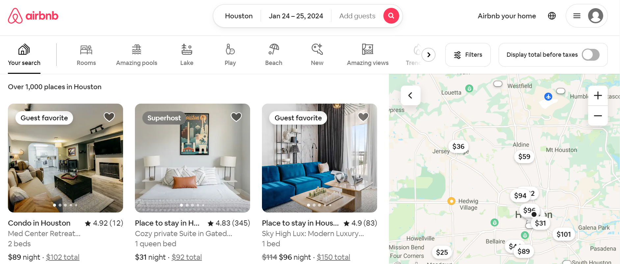
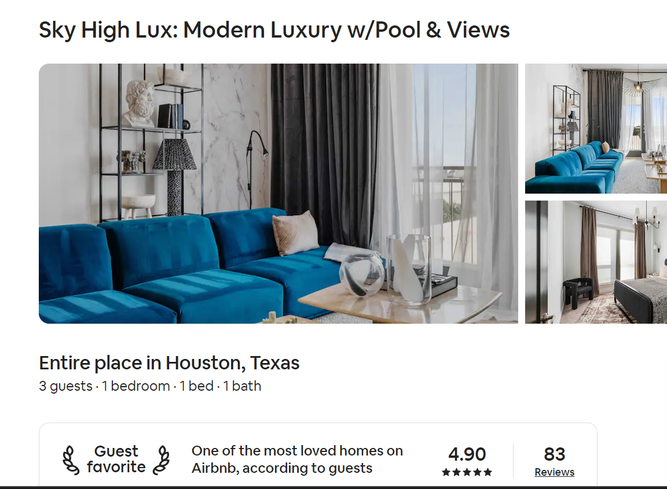
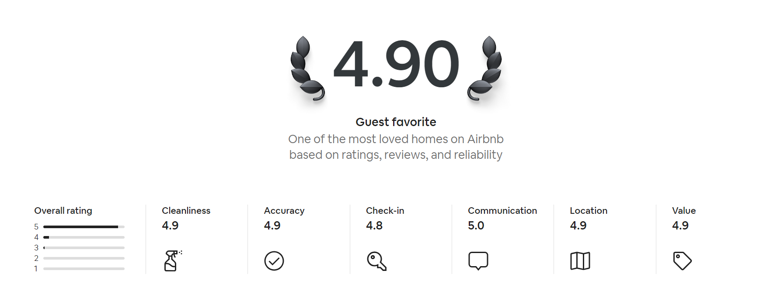
Business Insights
Recommendations
Display predicted high-rate listings in green, making it easier for users to quickly assess the quality of a listing. This visual update aims to enhance the user experience by providing a more intuitive and immediate understanding of a property's reputation even for newer properties.

Slide 15
References
References
Learnings from the project
Challenge Hypotheses: While it's natural to form initial hypotheses, we discovered unexpected trends after data analysis.
Target-Dependent Modeling: The choice of the best predictive model is highly dependent on the specific goal, whether it's forecasting ratings or predicting booking likelihood.
Importance of Feature Selection: Identify which features are most predictive for your specific objectives. Different targets might require focusing on different subsets of features.
https://masterhost.ca/airbnb-profitabilityhouston/#:~:text=The%20Houston%20Airbnb%20market%20manifests,Max%20Daily%20Rate%20reaches%20%24204. https://www.mashvisor.com/blog/airbnb-houston/https://www.hostyapp.com/why-airbnb-in-houston-is-a-great-investment-short-review/
https://chat.openai.com/share/91c12a67-1726-4d4b-bb93-3ec6f0ebc691
https://chat.openai.com/share/d9498290-7e75-4f06-ad80-8779ad3ac9d3
https://chat.openai.com/c/07fc29e3-284a-4d9b-bc8f-ecd0b69114de
Effects of reputation on guest satisfaction: From the perspective of two-sided reviews on Airbnb: https://scholar.google.com/citations?view_op=view_citation&hl=en&user=O0YpdN8AAAAJ&citation_for_view=O0YpdN8AAAAJ:R3hNpaxXUhUC

Slide 16
BACKUP SLIDES Model performance for occupancy rate prediction
Model 2
Model 2 | Training R2 | Validation R2 | Training RMSE | Validation RMSE
Polynomial Regression | 0.867744 | 0.861158 | 0.063051 | 0.065165
Linear Regression | 0.680242 | 0.675288 | 0.098039 | 0.099656
Random Forest | 0.999645 | 0.997681 | 0.003265 | 0.008422
Gradient Boosting | 0.990638 | 0.988669 | 0.016776 | 0.018616
XGBoost | 0.999660 | 0.998804 | 0.003196 | 0.006048

Slide 17
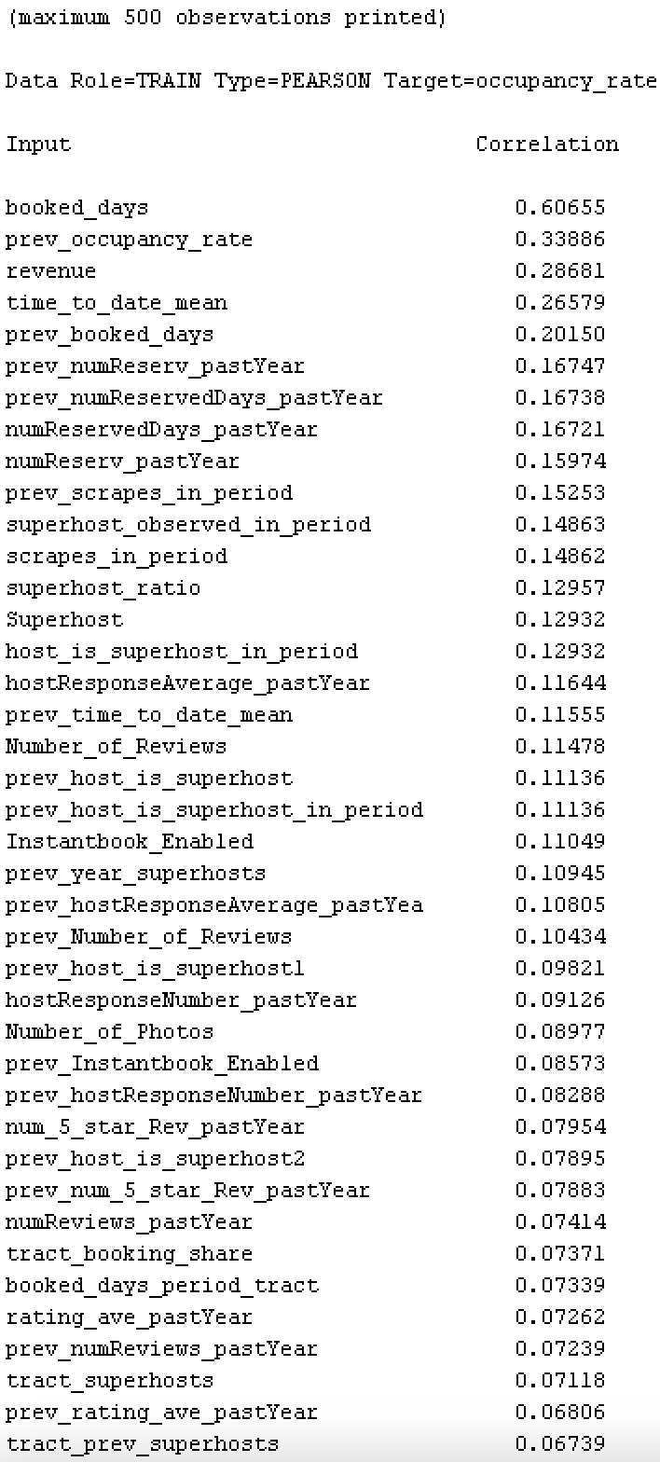
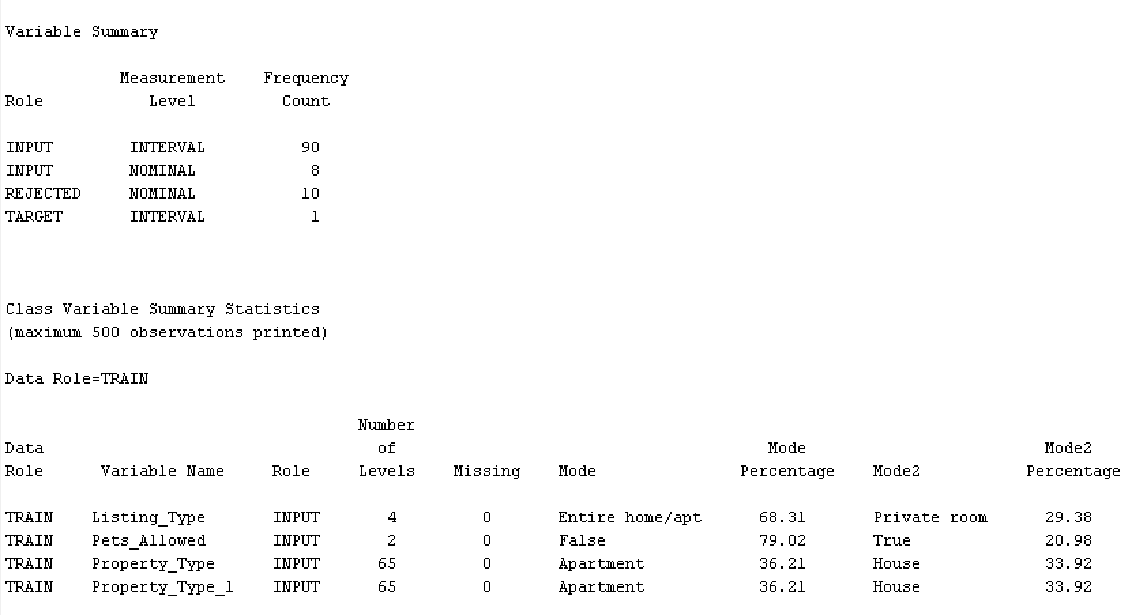
Summary Stats

Slide 18
Summary Stats
Raw Data

Slide 19
Step-by-step code flow
Models 1 & 2
Importing libraries
Loading the Dataset
import pandas as pd
from sklearn.model_selection import train_test_split
from sklearn.preprocessing import PolynomialFeatures, MaxAbsScaler, OneHotEncoder
from sklearn.impute import SimpleImputer
from sklearn.compose import ColumnTransformer
from sklearn.linear_model import LinearRegression
from sklearn.metrics import mean_squared_error, r2_score
import numpy as np
from sklearn.pipeline import Pipeline
# Load the dataset data = pd.read_csv('/content/AirbnbHouston_Preprocessed_dataset 2.csv') # Adjust path as needed
In this part, you import the necessary Python libraries for data manipulation, machine learning, and evaluation.
Here, you load your dataset from a CSV file into a Pandas DataFrame. The path to the dataset file is specified, and you should adjust it to your file's actual location.

Slide 20
Model 2
Defining Target and Features
Splitting the Dataset
# Define the target variable and features
target = 'occupancy_rate'
features = ['host_is_superhost_in_period', 'numReviews_pastYear', 'booked_days', ...] # List of feature names
X = data[features]
y = data[target]
# Splitting the dataset into training and validation sets (60:40)
X_train, X_val, y_train, y_val = train_test_split(X, y, test_size=0.4, random_state=42)
You specify the target variable ('occupancy_rate') and the list of feature columns that will be used for modeling. X contains the feature data, and y contains the target variable.
The dataset is split into training and validation sets using a 60:40 ratio. The random_state ensures reproducibility.

Slide 21
Model 2
Data Preprocessing
Creating Polynomial Features
# Preprocessing
numeric_cols = X.select_dtypes(include=['int64', 'float64']).columns
categorical_cols = X.select_dtypes(include=['object', 'category']).columns
numeric_transformer = Pipeline(steps=[...]) # Numeric data preprocessing
categorical_transformer = Pipeline(steps=[...]) # Categorical data preprocessing
preprocessor = ColumnTransformer(transformers=[...]) # Apply transformations to numeric and categorical columns
X_train_processed = preprocessor.fit_transform(X_train)
X_val_processed = preprocessor.transform(X_val)
# Create polynomial features
poly_features = PolynomialFeatures(degree=2)
X_train_poly = poly_features.fit_transform(X_train_processed)
X_val_poly = poly_features.transform(X_val_processed)
This section performs data preprocessing steps, including imputation (filling missing values) and scaling for numeric features and one-hot encoding for categorical features. The ColumnTransformer is used to apply these transformations to the appropriate columns in the dataset.
Polynomial features of degree 2 are generated from the preprocessed data. This allows the model to capture more complex relationships between features.

Slide 22
Model 1
Linear Regression Model
Predictions and Evaluation
# Linear Regression Model
linear_reg = LinearRegression()
linear_reg.fit(X_train_poly, y_train)
# Predict and evaluate on training and validation data
y_train_pred = linear_reg.predict(X_train_poly)
y_val_pred = linear_reg.predict(X_val_poly)
train_mse = mean_squared_error(y_train, y_train_pred)
train_r2 = r2_score(y_train, y_train_pred)
val_mse = mean_squared_error(y_val, y_val_pred)
val_r2 = r2_score(y_val, y_val_pred)
# Print model summary
print("Model Summary:")
print("Training MSE:", train_mse)
print("Training R-squared:", train_r2)
print("Validation MSE:", val_mse)
print("Validation R-squared:", val_r2)
print("Intercept:", linear_reg.intercept_)
print("Coefficients:", linear_reg.coef_)
A linear regression model is instantiated and trained on the polynomial features of the training data.
The model is used to make predictions on both the training and validation datasets, and various evaluation metrics such as Mean Squared Error (MSE), R-squared

Slide 23
Random Forest Model
Model 1
Predictions and Evaluation
X = sampled_data[selected_columns]
y = sampled_data['Rating Overall']
# Identify numeric and categorical features
numeric_features = X.select_dtypes(include=[np.number]).columns
categorical_features = X.select_dtypes(include=[np.object]).columns
# Create preprocessing pipeline
numeric_transformer = Pipeline(steps=[
('imputer', SimpleImputer(strategy='mean')),
('scaler', StandardScaler())
])
categorical_transformer = Pipeline(steps=[
('imputer', SimpleImputer(strategy='most_frequent')),
('onehot', OneHotEncoder(handle_unknown='ignore'))
])
preprocessor = ColumnTransformer(
transformers=[
('num', numeric_transformer, numeric_features),
('cat', categorical_transformer, categorical_features)
])
# Random Forest
rf_model = Pipeline(steps=[('preprocessor', preprocessor),
('regressor', RandomForestRegressor(n_estimators=100, random_state=42))])
X_train, X_test, y_train, y_test = train_test_split(X, y, test_size=0.30, random_state=42)
# Fit the Random Forest model
rf_model.fit(X_train, y_train)
# Predictions
y_pred_rf = rf_model.predict(X_test)
# Evaluate Random Forest
mse_rf = mean_squared_error(y_test, y_pred_rf)
r2_rf = r2_score(y_test, y_pred_rf) print("Random Forest:")
print("RMSE:", mse_rf)
print("R-squared:", r2_rf)
A Random Forest regression model is initialized and fitted to the training dataset, leveraging an ensemble of decision trees to grasp intricate patterns and relationships present in the data.
The model is used to make predictions on both the training and validation datasets, and various evaluation metrics such as Mean Squared Error (MSE), R-squared

Slide 24

Top influencial Features & their contribution (1/2)
Random Forest
Previous Rating Overall: Importance - 0.874963
Number of Reviews: Importance - 0.068726
Average Rating in the Past Year: Importance - 0.016475
Previous Number of Reviews: Importance - 0.007278
Booked Days Average Price: Importance - 0.003343
Tract Housing Units: Importance - 0.003223
Proportion of 5-Star Reviews in the Past Year: Importance - 0.002739
Previous Revenue: Importance - 0.002578
Previous Nightly Rate: Importance - 0.002034
Longitude: Importance - 0.001286
Number of Cancellations in the Past Year: Importance - 0.000948

Slide 25

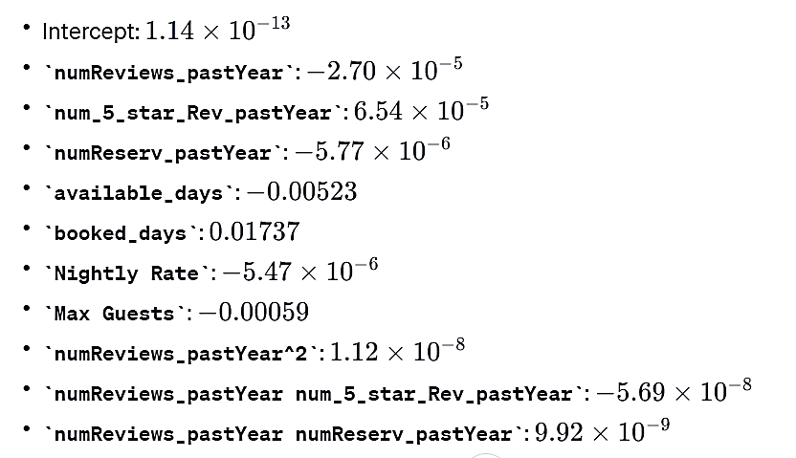
Top influencial Features & their contribution (2/2)
Polynomial Regression

